Slide 1
Project 1 Presentation
Nurlan S

Slide 2
Project Requirements
The application must be able to create, read, update, and delete.
- Use at least 3 different tables/collections
- The application must have a login feature, as well as user/admin roles
- Logging of events should be implemented

Slide 3
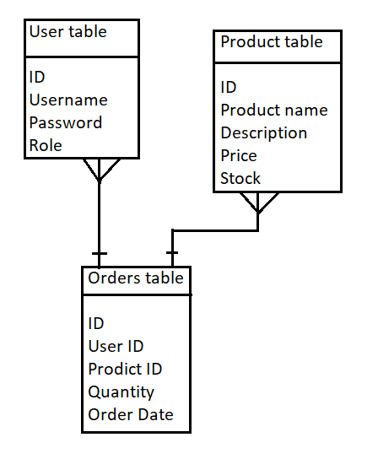
P1 - ERD
3 tables - Users, Products, Orders ID - primary key of each table User ID, Product ID - foreign keys of Orders Table
Users to orders - One to many relationship Products to orders - One to many relationship

Slide 4
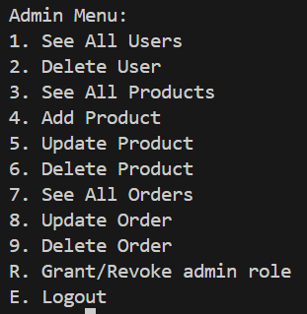
Admin mode
Delete Users Add/Update/Delete product Update/Delete ANY order Grant/Revoke admin role Unable to make orders

Slide 5
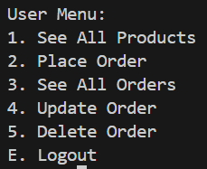
User mode
Make order Able to see only his/her orders Update/Delete only his/her orders

Slide 6
Products update
Admin have ability to add any product and change any product including stock Every time order is made, stock decreases, any time order updated or deleted, stock of the product updates.

